Slide 1

relational RDBMS
Marzougui chaker

Slide 2
SUMMARY :
What Is a Database
What Is a DBMS
What Is a RDBMS
relational RDBMS : MySQL , PostgreSQL , SQL Server
A comparison between MySQL vs PostgreSQL vs SQL Server

Slide 3
What Is a Database?
An organised, machine-readable collection of symbols, to be interpreted as a true account of some enterprise.
Machine-updatable, too …
A database is typically available to a community of users, with possibly varying requirements.

Slide 4
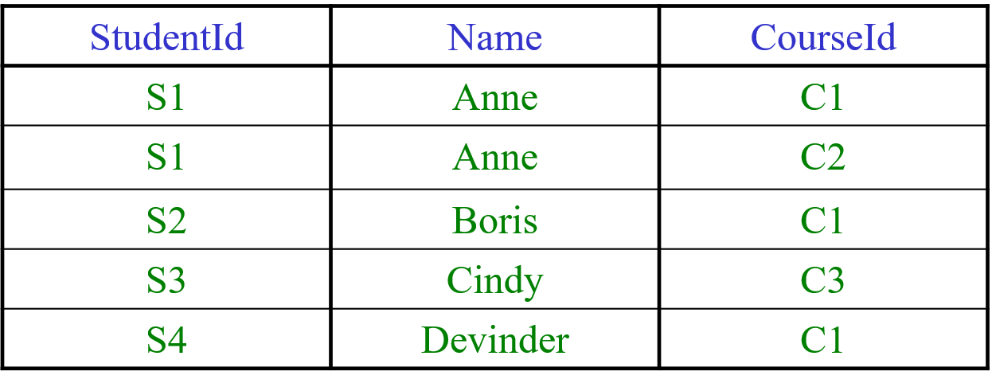
What Is a Relational Database?
A database whose symbols are organised into a collection of relations. Here is a relation, shown in tabular form:
Might be the value currently assigned to ENROLMENT, a relation variable (“relvar”).

Slide 5
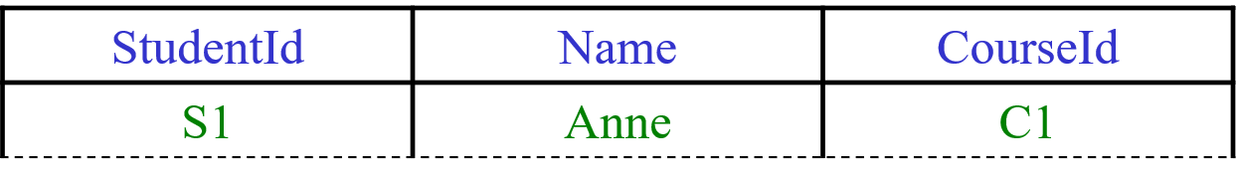
Anatomy of a Relation
attribute name
attribute values
n-tuple, or tuple. This is a 3-tuple. The tuples constitute the body of the relation. The number of tuples in the body is the cardinality of the relation.
Heading (a set of attributes) The degree of this heading is 3,
which is also the degree of the relation.

Slide 6
What Is a DBMS?
A piece of software for managing databases and providing access to them.
A DBMS responds to imperatives (“statements”) given by application programs, custom-written or general-purpose, executing on behalf of users.
Imperatives are written in the database language of the DBMS (e.g., SQL).
Responses include completion codes, messages and results of queries.

Slide 7
In response to requests given by application programs:
creates and destroys variables
takes note of integrity rules (constraints)
takes note of authorisations (who is allowed to do what, to what)
updates variables (honouring constraints and authorisations)
provides results of queries
and more
Now, how does a relational DBMS do these things? …

Slide 8
What Is a RDBMS?
A relational database management system (RDBMS) is a collection of programs and capabilities that enable IT teams and others to create, update, administer and otherwise interact with a relational database. RDBMSes store data in the form of tables, with most commercial relational database management systems using Structured Query Language (SQL) to access the database. However, since SQL was invented after the initial development of the relational model, it is not necessary for RDBMS use.
The RDBMS is the most popular database system among organizations across the world. It provides a dependable method of storing and retrieving large amounts of data while offering a combination of system performance and ease of implementation.

Slide 9
Advantages of MySQL
Uses of RDBMS
Other advantages of the RDBMS include:
Flexibility -- updating data is more efficient since the changes only need to be made in one place.
Maintenance -- database administrators can easily maintain, control and update data in the database. Backups also become easier since automation tools included in the RDBMS automate these tasks.
Data structure -- the table format used in RDBMSes is easy to understand and provides an organized and structural manner through which entries are matched by firing queries
Relational database management systems are frequently used in disciplines such as manufacturing, human resources and banking. The system is also useful for airlines that need to store ticket service and passenger documentation information as well as universities maintaining student databases.
Some examples of specific systems that use RDBMS include IBM, Oracle, MySQL, Microsoft SQLServer and PostgreSQL.

Slide 10
RDBMS vs. DBMS
In general, databases store sets of data that can be queried for use in other applications. A database management system supports the development, administration and use of database platforms.
An RDBMS is a type of database management system (DBMS) that stores data in a row-based table structure which connects related data elements. An RDBMS includes functions that maintain the security, accuracy, integrity and consistency of the data. This is different than the file storage used in a DBMS.

Slide 11
MySQL , PostgreSQL , SQL Server :
My SQL
Postgre SQL
Sql server

Slide 12
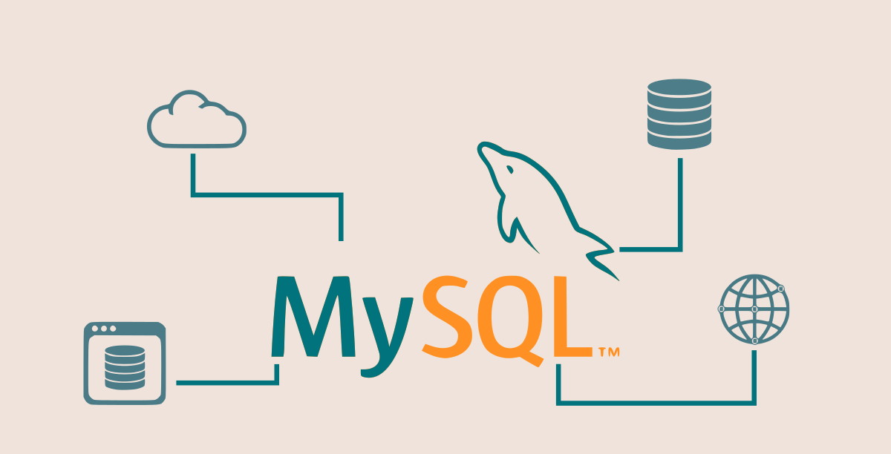
MySQL

Slide 13
Key features of MySQL
As an RDBMS, MySQL is based on SQL. The key features of MySQL are as follows:
The creators of this RDBMS used C and C++ to create MySQL.
MySQL uses a client-server architecture.
This RDBMS works with a wide range of operating systems like Windows, Linux, Unix, OS/2, FreeBSD, etc.
You can install and run MySQL on all key platforms.

Slide 14
Advantages of MySQL
Disadvantages of MySQL
Apart from being an open-source and free RDBMS, MySQL offers the following advantages:
The ease of installation
Lightweight.
Tooling support
Compatibility:
The ease of use
Security
Performance
Scalability
Availability
High productivity
Efficiency
Support
MySQL has a few disadvantages too, which are as follows:
Limitations vis-a-vis embedding in an application
Business logic-related limitations
Stability issues
The dependency on add-ons
Limitations concerning tools when compared to paid databases
MySQL isn’t very efficient when handling large databases.
MySQL versions prior to 5.0 don’t support commits and stored procedures.

Slide 15
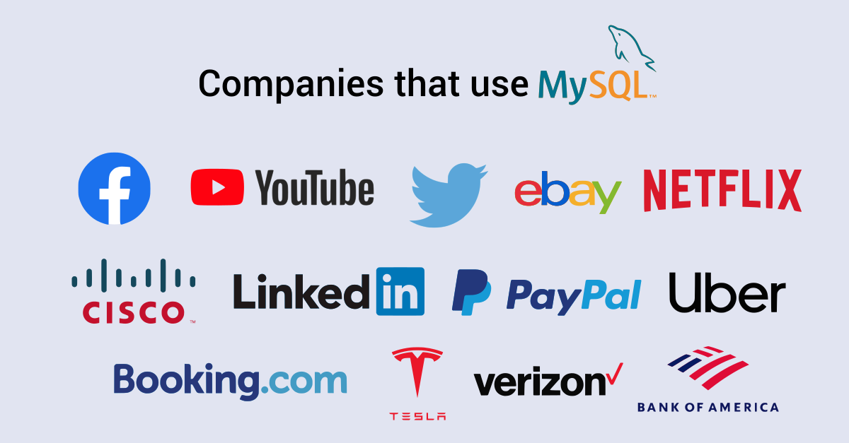
The following are a few examples of prominent companies/apps that use MySQL:
Developers use MySQL widely for web application development. Popular “Content Management Systems” (CMSs) like WordPress, Joomla, Drupal, etc. use MySQL.

Slide 16
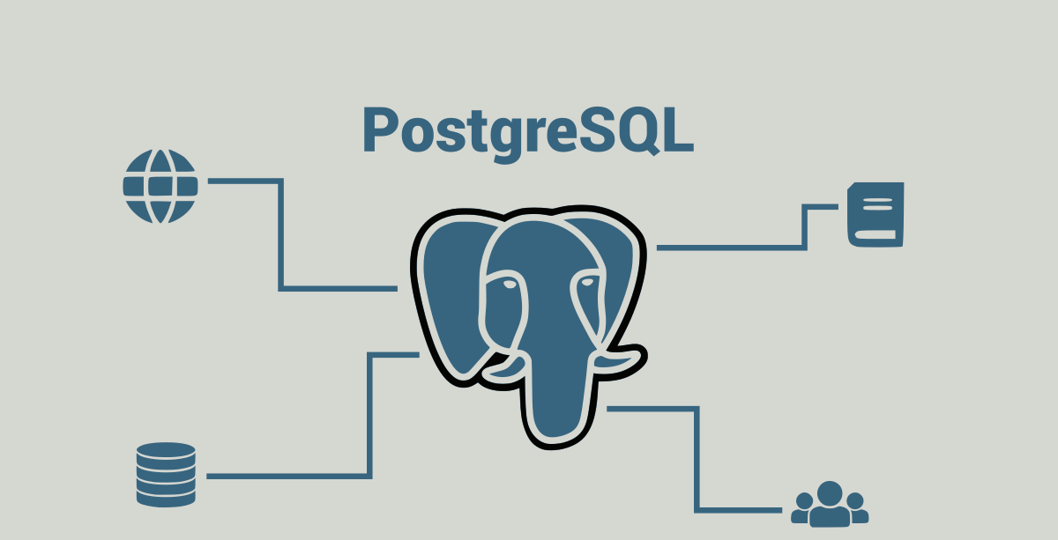
Postgre SQL

Slide 17
Key features of PostgreSQL
The following are the noticeable features of PostgreSQL:
This open-source RDBMS is free.
Its creators used the C language to develop PostgreSQL.
PostgreSQL supports all the key platforms like Windows, Linux, Mac, etc.
This RDBMS uses SQL and offers features similar to traditional RDBMSs like Oracle and DB2.
PostgreSQL offers noticeable extensibility. You can use it along with other popular RDBMSs like Oracle and MySQL. Furthermore, you can use it along with popular NoSQL databases like MongoDB.
PostgreSQL supports all popular languages like Java, Python, C, C++, C#, JavaScript, Ruby, Go, etc.

Slide 18
Advantages of PostgreSQL
Disadvantages of PostgreSQL
PostgreSQL offers the following advantages:
Powerful features
The ease of handling transactions
Code comments
Parameters
Extensibility
Security
“Rich” SQL
Flexibility
Performance
Popularity
Support
PostgreSQL has a few disadvantages, which are as follows:
The lack of data compression
Analytics-related limitations
Performance-related limitations
Administration-related challenges

Slide 19
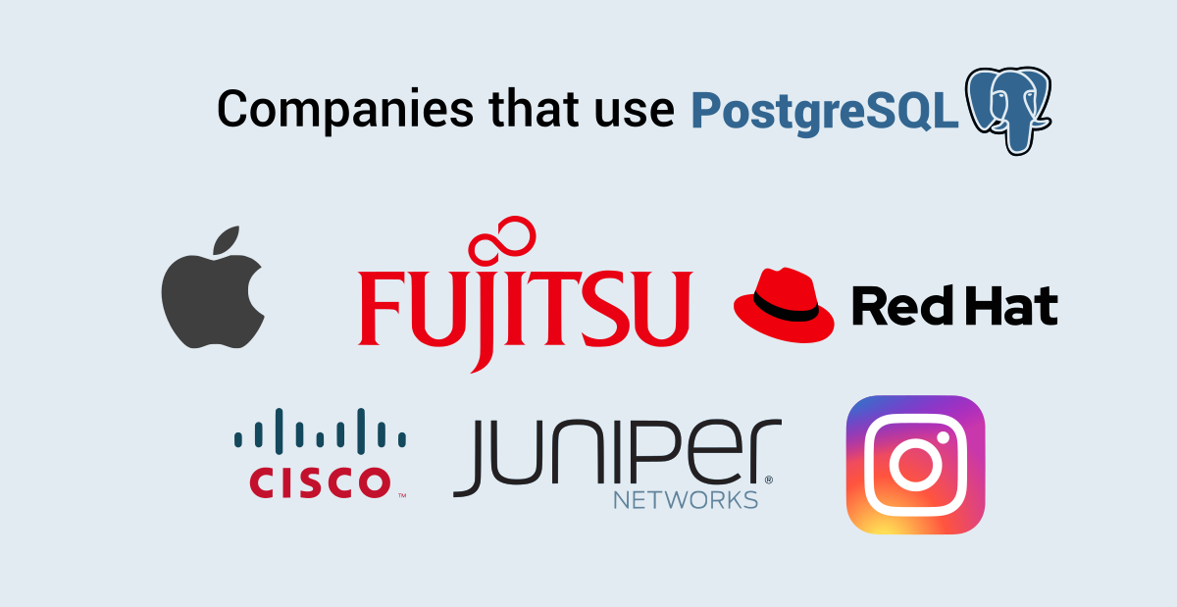
The following are examples of well-known companies/apps that use PostgreSQL:
Many organizations and developers use PostgreSQL to develop applications, websites, and tools. In addition to using PostgreSQL as a general-purpose transaction database, you can use it for geospatial use cases too.

Slide 20
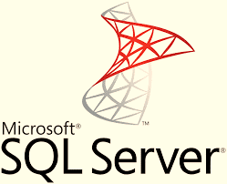
SQL Server

Slide 21
Key features of SQL Server
The following are the noticeable features of SQL Server
1. Intelligence on all your data with Big Data clusters: being able to query your entire data estate from SQL Serve to Oracle without replication. 2. Choice of Language and Platform: From Windows or Linux, to Kubernetes deployments. 3. Intelligent database capabilities: in-memory, persistent memory support, in-memory optimized tempbd 4. Data encryption and compliance: Its data protection, monitoring and classification system has made it one of the top most secure platforms according to the National Institute of Standards and Technology database for 9 years. 5. Mobile BI and scalability: Allowing you to easily integrate your database management systems with any device and Azure services for better performance and analytical capabilities on data.
SQL Server is a relational database management system, or RDBMS, developed and marketed by Microsoft.
Similar to other RDBMS software, SQL Server is built on top of SQL, a standard programming language for interacting with relational databases. SQL Server is tied to Transact-SQL, or T-SQL, the Microsoft’s implementation of SQL that adds a set of proprietary programming constructs.
SQL Server works exclusively on the Windows environment for more than 20 years. In 2016, Microsoft made it available on Linux. SQL Server 2017 became generally available in October 2016 that ran on both Windows and Linux.

Slide 22
Advantages of SQL Server
Disadvantages of SQL Server
1. Increases data security
2. Ease of configuration
3. Optimized data storage
4. Data recovery support
1. Cost
2. Restricted compatibility
3. Hardware restrictions

Slide 23
A comparison between MySQL vs PostgreSQL vs SQL Server

Slide 24
The focus on advanced features in MySQL vs PostgreSQL vs SQL Server
Are you looking for powerful features when you choose an open-source RDBMS? You should use PostgreSQL. It supports concurrency well. Furthermore, it offers other powerful features like nested transactions.
PostgreSQL complies completely with the ACID standards. This makes it a better choice for use cases where data integrity is very important. PostgreSQL offers the best compatibility with SQL standards, and it’s ahead of MySQL and SQL Server in this regard.
The comparison of performance between MySQL vs PostgreSQL vs SQL Server
Are you looking for speed and performance in an open-source RDBMS? Choose MySQL. We talked about a few limitations in MySQL concerning capabilities, however, that provides one advantage too! Since the developers behind MySQL didn’t implement certain complex features, this RDBMS can offer speed. It takes a lead over PostgreSQL and SQL Server in this regard

Slide 25
The comparison of security between MySQL vs PostgreSQL vs SQL Server
Does security have a high priority in your project requirements? You should choose MySQL over PostgreSQL and SQL Server. MySQL allows you to set passwords at the level of the root user. You can set the security level of the password at the installation-level. You can remove unwanted test databases, furthermore, you can grant access privileges at the level of a user.
The comparison of popularity between MySQL vs PostgreSQL vs SQL Server
Do you want to find developers easily, therefore, you want to use the most popular open-source RDBMS? Most developers will likely have skills in such an RDBMS. This makes finding developers easier. In this case, you should choose MySQL. While PostgreSQL and SQLite are popular too, MySQL enjoys higher popularity
The comparison of support between MySQL vs PostgreSQL vs SQL Server
Do you want excellent community support for the open-source RDBMS you choose? After all, you aren’t using a commercial product. Robust community support has importance for you. You should choose PostgreSQL in this case since a large and vibrant community supports it. MySQL and SQLite have their developer communities too. However, PostgreSQL maintains a lead in this regard.

Slide 26
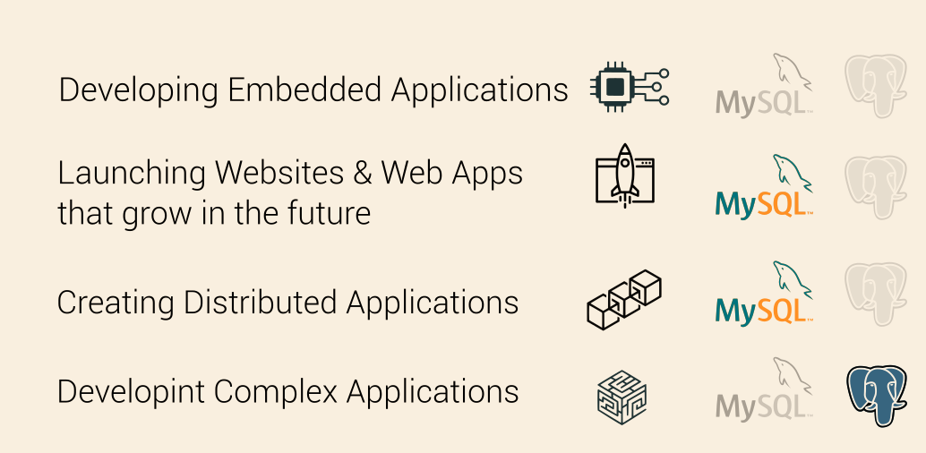
WHEN TO USE MYSQL VS POSTGRESQL ?

Slide 27
System Properties Comparison Microsoft SQL Server vs. MySQL vs. PostgreSQL
Name | Microsoft SQL Server | MySQL | PostgreSQL
Description | Relational DBMS | Relational DBMS | Relational DBMS
Secondary database models | Document store Graph DBMS Spatial DBMS | Document store Spatial DBMS | Document store Spatial DBMS
Developer | Microsoft | Oracle | PostgreSQL Global Development Group
Initial release | 1989 | 1995 | 1989
License | commercial | Open Source | Open Source
Cloud-based only | no | no | no

Slide 28
Implementation language | C++ | C and C++ | C
Server operating systems | Linux Windows | FreeBSD Linux OS X Solaris Windows | FreeBSD HP-UX Linux NetBSD OpenBSD OS X Solaris Unix Windows
Supported programming languages | C# C++ Delphi Go Java JavaScript (Node.js) PHP Python R Ruby Visual Basic | Ada C C# C++ Eiffel Haskell Java JavaScript (Node.js) PHP Python Ruby | .Net C C++ Delphi Java JavaScript (Node.js) Perl PHP Python Tcl

Slide 29

THANK YOU FOR YOUR ATTENTION

